Slide 1
Assembly Language for x86 Processors 6th Edition
Kip R. Irvine
Chapter 6: Conditional Processing

Slide 2
Chapter Overview
Boolean and Comparison Instructions
Conditional Jumps
Conditional Loop Instructions
Conditional Structures

Slide 3
Boolean and Comparison Instructions
CPU Status Flags
AND Instruction
OR Instruction
XOR Instruction
NOT Instruction
Applications
TEST Instruction
CMP Instruction

Slide 4
Status Flags - Review
The Zero flag is set when the result of an operation equals zero.
The Carry flag is set when an instruction generates a result that is too large (or too small) for the destination operand.
The Sign flag is set if the destination operand is negative, and it is clear if the destination operand is positive.
The Overflow flag is set when an instruction generates an invalid signed result.
The Parity flag is set when an instruction generates an even number of 1 bits in the low byte of the destination operand.
The Auxiliary Carry flag is set when an operation produces a carry out from bit 3 to bit 4

Slide 5
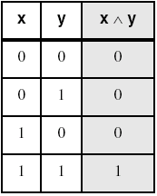
AND Instruction
Performs a Boolean AND operation between each pair of matching bits in two operands
Syntax:
AND destination, source
(same operand types as MOV)
AND

Slide 6
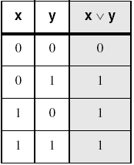
OR Instruction
Performs a Boolean OR operation between each pair of matching bits in two operands
Syntax:
OR destination, source
OR

Slide 7
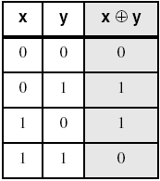
XOR Instruction
Performs a Boolean exclusive-OR operation between each pair of matching bits in two operands
Syntax:
XOR destination, source
XOR
XOR is a useful way to toggle (invert) the bits in an operand.

Slide 8
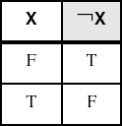
NOT Instruction
Performs a Boolean NOT operation on a single destination operand
Syntax:
NOT destination
NOT

Slide 9
Applications (1 of 2)
Task: Convert the character in AL to upper case.
Solution: Use the AND instruction to clear bit 5.
mov al,'a' ; AL = 01100001b
and al,11011111b ; AL = 01000001b

Slide 10
Applications (2 of 2)
Task: Convert a binary decimal byte into its equivalent ASCII decimal digit.
Solution: Use the OR instruction to set bits 4 and 5.
mov al,6 ; AL = 00000110b
or al,00110000b ; AL = 00110110b
The ASCII digit '6' = 00110110b

Slide 11
TEST Instruction
Performs a nondestructive AND operation between each pair of matching bits in two operands
No operands are modified, but the Zero flag is affected.
Example: jump to a label if either bit 0 or bit 1 in AL is set.
test al,00000011b
jnz ValueFound
Example: jump to a label if neither bit 0 nor bit 1 in AL is set.
test al,00000011b
jz ValueNotFound

Slide 12
CMP Instruction (1 of 2)
Compares the destination operand to the source operand
Nondestructive subtraction of source from destination (destination operand is not changed)
Syntax: CMP destination, source
Example: destination == source
mov al,5
cmp al,5 ; Zero flag set
Example: destination < source
mov al,4
cmp al,5 ; Carry flag set

Slide 13
CMP Instruction (2 of 2)
Example: destination > source
mov al,6
cmp al,5 ; ZF = 0, CF = 0
(both the Zero and Carry flags are clear)

Slide 14
What's Next
Boolean and Comparison Instructions
Conditional Jumps
Conditional Loop Instructions
Conditional Structures
Application: Finite-State Machines
Conditional Control Flow Directives

Slide 15
Conditional Jumps
Jumps Based On . . .
Specific flags
Equality
Unsigned comparisons
Signed Comparisons

Slide 16
Jcond Instruction
A conditional jump instruction branches to a label when specific register or flag conditions are met
Specific jumps:
JB, JC - jump to a label if the Carry flag is set
JE, JZ - jump to a label if the Zero flag is set
JS - jump to a label if the Sign flag is set
JNE, JNZ - jump to a label if the Zero flag is clear
JECXZ - jump to a label if ECX = 0

Slide 17
Jcond Ranges
Prior to the 386:
jump must be within –128 to +127 bytes from current location counter
x86 processors:
32-bit offset permits jump anywhere in memory

Slide 18
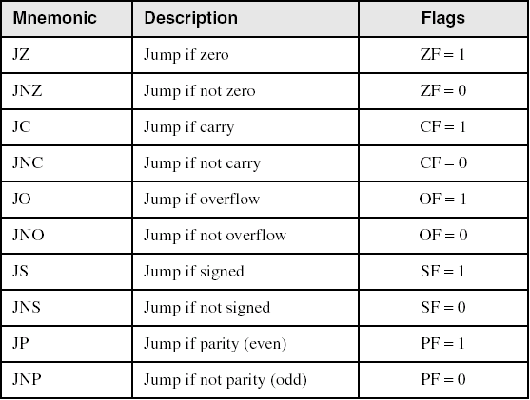
Jumps Based on Specific Flags

Slide 19
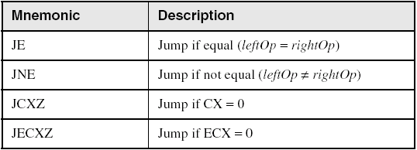
Jumps Based on Equality

Slide 20
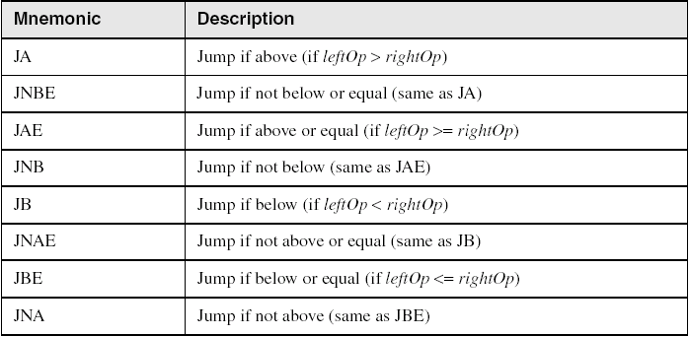
Jumps Based on Unsigned Comparisons

Slide 21
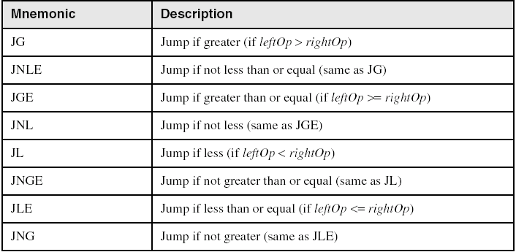
Jumps Based on Signed Comparisons

Slide 22
Applications (1 of 3)
Task: Jump to a label if unsigned EAX is greater than EBX
Solution: Use CMP, followed by JA
cmp eax,ebx
ja Larger
Task: Jump to a label if signed EAX is greater than EBX
Solution: Use CMP, followed by JG
cmp eax,ebx
jg Greater

Slide 23
Applications (2 of 3)
Jump to label L1 if unsigned EAX is less than or equal to Val1
cmp eax,Val1
jbe L1 ; below or equal
Jump to label L1 if signed EAX is less than or equal to Val1
cmp eax,Val1
jle L1

Slide 24
Applications (3 of 3)
Compare unsigned AX to BX, and copy the larger of the two into a variable named Large
mov Large,bx
cmp ax,bx
jna Next
mov Large,ax
Next:
Compare signed AX to BX, and copy the smaller of the two into a variable named Small
mov Small,ax
cmp bx,ax
jnl Next
mov Small,bx
Next:

Slide 25
Block-Structured IF Statements
Assembly language programmers can easily translate logical statements written in C++/Java into assembly language. For example:
if( op1 == op2 )
X = 1;
else
X = 2;
mov eax,op1
cmp eax,op2
jne L1
mov X,1
jmp L2
L1: mov X,2
L2:

Slide 26
Your turn . . .
Implement the following pseudocode in assembly language. All values are unsigned:
if( ebx <= ecx )
{
eax = 5;
edx = 6;
}
cmp ebx,ecx
ja next
mov eax,5
mov edx,6
next:
(There are multiple correct solutions to this problem.)

Slide 27
Your turn . . .
Implement the following pseudocode in assembly language. All values are 32-bit signed integers:
if( var1 <= var2 )
var3 = 10;
else
{
var3 = 6;
var4 = 7;
}
mov eax,var1
cmp eax,var2
jle L1
mov var3,6
mov var4,7
jmp L2
L1: mov var3,10
L2:
(There are multiple correct solutions to this problem.)

Slide 28
Compound Expression with AND (1 of 3)
When implementing the logical AND operator, consider that HLLs use short-circuit evaluation
In the following example, if the first expression is false, the second expression is skipped:
if (al > bl) AND (bl > cl)
X = 1;

Slide 29
Compound Expression with AND (2 of 3)
if (al > bl) AND (bl > cl)
X = 1;
This is one possible implementation . . .
cmp al,bl ; first expression...
ja L1
jmp next
L1:
cmp bl,cl ; second expression...
ja L2
jmp next
L2: ; both are true
mov X,1 ; set X to 1
next:

Slide 30
Compound Expression with AND (3 of 3)
if (al > bl) AND (bl > cl)
X = 1;
But the following implementation uses 29% less code by reversing the first relational operator. We allow the program to "fall through" to the second expression:
cmp al,bl ; first expression...
jbe next ; quit if false
cmp bl,cl ; second expression...
jbe next ; quit if false
mov X,1 ; both are true
next:

Slide 31
Your turn . . .
Implement the following pseudocode in assembly language. All values are unsigned:
if( ebx <= ecx
&& ecx > edx )
{
eax = 5;
edx = 6;
}
cmp ebx,ecx
ja next
cmp ecx,edx
jbe next
mov eax,5
mov edx,6
next:
(There are multiple correct solutions to this problem.)

Slide 32
Compound Expression with OR (1 of 2)
When implementing the logical OR operator, consider that HLLs use short-circuit evaluation
In the following example, if the first expression is true, the second expression is skipped:
if (al > bl) OR (bl > cl)
X = 1;

Slide 33
Compound Expression with OR (2 of 2)
if (al > bl) OR (bl > cl)
X = 1;
We can use "fall-through" logic to keep the code as short as possible:
cmp al,bl ; is AL > BL?
ja L1 ; yes
cmp bl,cl ; no: is BL > CL?
jbe next ; no: skip next statement
L1: mov X,1 ; set X to 1
next:

Slide 34
WHILE Loops
A WHILE loop is really an IF statement followed by the body of the loop, followed by an unconditional jump to the top of the loop. Consider the following example:
while( eax < ebx)
eax = eax + 1;
This is a possible implementation:
top: cmp eax,ebx ; check loop condition
jae next ; false? exit loop
inc eax ; body of loop
jmp top ; repeat the loop
next:

Slide 35
Your turn . . .
Implement the following loop, using unsigned 32-bit integers:
while( ebx <= val1)
{
ebx = ebx + 5;
val1 = val1 - 1
}
top: cmp ebx,val1 ; check loop condition
ja next ; false? exit loop
add ebx,5 ; body of loop
dec val1
jmp top ; repeat the loop
next:

